Slide 1
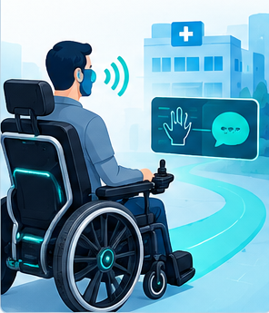
1
AI Assistive Technology with Smart Communication System
• ESP32-based assistive mobility and communication system
• Voice and hand gestures support independent movement
• Connected hospital ecosystem enables coordinated patient care
Assistive Healthcare Technology

Slide 2
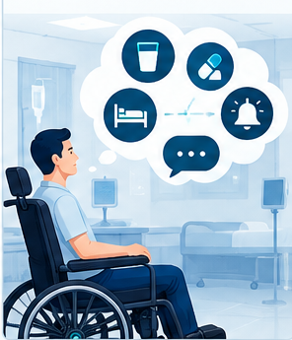
2
Problem Statement
• Paralysed patients face severe mobility limitations
• Communication barriers reduce independence and comfort
• Emergency needs require fast and reliable assistance
Assistive Healthcare Technology

Slide 3
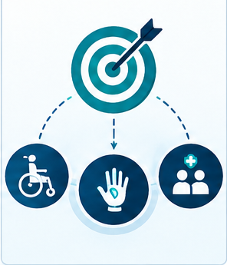
3
Objectives
• Enable wheelchair movement through voice and gestures
• Translate hand gestures into spoken patient requests
• Deliver coordinated alerts across hospital dashboards
Assistive Healthcare Technology

Slide 4
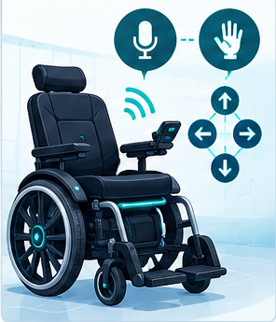
5
Smart Wheelchair
• Voice commands provide hands-free wheelchair control
• Hand gestures offer alternative movement commands
• Sensors support safe indoor mobility and navigation
Assistive Healthcare Technology

Slide 5
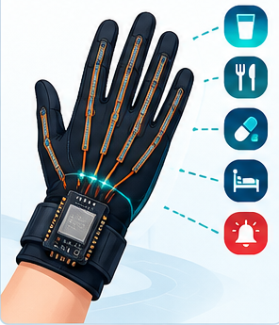
6
Flex-Sensor Gesture Glove
• Flex sensors detect individual finger bending
• Gestures map to predefined communication phrases
• Requests appear on screen and speak aloud
Assistive Healthcare Technology

Slide 6
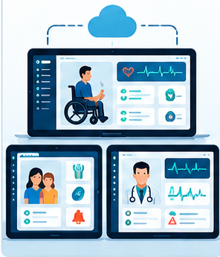
7
Web App Dashboards
• Patient dashboard shows requests and system status
• Attender dashboard receives care and emergency updates
• Doctor dashboard monitors clinical events and telemetry
Assistive Healthcare Technology

Slide 7
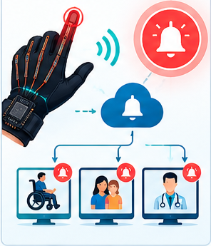
8
Emergency & Alert Flow
• Emergency gesture triggers an immediate alert
• Doctors, attenders, and staff receive notifications
• Every event is timestamped and permanently logged
Assistive Healthcare Technology

Slide 8

9
Safety & Reliability
• Obstacle detection reduces wheelchair collision risk
• Validated gestures prevent unintended command activation
• Continuous monitoring supports reliable hospital operation
Assistive Healthcare Technology

Slide 9
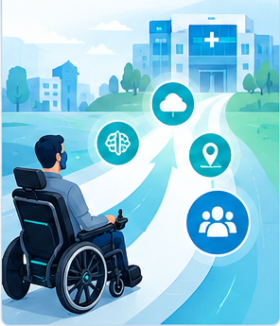
10
Conclusion & Future Scope
• Improves patient independence and communication
• Strengthens coordination between patients and caregivers
• Future scope includes AI navigation and IoT
Assistive Healthcare Technology

